Slide 1
Dataset Discovery in Data Lakes
By-
Akshay, Kruthi, Nikhil
Group 2

Slide 2
Abstract
Data analytics can benefit from datasets that are collected without their conceptual relationships being explicitly known. Here, a solution was proposed to the problem of dataset discovery in data lakes that enables us to pull out datasets that might contribute to wrangling out a given target. In this approach they define similarity distances between features and to take those distances as measurements of relatedness w.r.t. a target table. And later comparing the approach with prior work, where pertinent, and showing significant improvements in all of precision, recall, target coverage, indexing and discovery times.

Slide 3
Introduction
The number of external and internal datasets for organizations continues to grow, but it is difficult to discover the most useful ones for a given analytic task.
We go through several stages for analysis on data from a data lake.One of the stages in it is dataset discovery which we will be working on. Given a target, datasets from the data lake that are unionable and joinable with the target were found.They should be such that they populate as many target attributes as possible through this method.
In order to do so solutions were proposed which would be contribute to a novel approach for dataset discovery in data lakes. five types of similarity features from the datasets and target were extracted:
Schema level information
Extent overlap
Word embedding similarity
Format representation similarity
Domain distribution similarity
Notes:
In this paper, we take a data lake to be a repository whose items are datasets about which, we assume, we have no more metadata than, when in tabular form, their attribute names, and possibly their domain-independent types (i.e., string, integer, etc.) .
We view open government data repositories as exemplar data lakes

Slide 4
Related Work
Two already proposed methods were taken as a base to build and measure performance. Aurum and TUS(Tabel Union Search) are those already proposed methods.
Based on several similarity metrics, we build upon locality-sensitive hashing (LSH) and propose two hash functions with high probability of collision for inputs with high Jaccard similarity and high cosine similarity.For a small answer size, the LSH Forest extension is used and the LSH Ensemble indexing scheme is used.
Relatedness Discovery
Extending Relatedness through Join Paths

Slide 5
Relatedness Discovery
Define relatedness as the degree to which a dataset is relevant for populating a target dataset.
Given two datasets, if they are related to the same target attribute, the datasets are unionable. If they are also joinable, then the projection from their join result of the attributes related to some target attribute is potentially related to the target itself.
Attribute Relatedness: Relatedness evidence
Attribute Relatedness: Distance Computation
Attribute Relatedness: The Numeric Case
Deciding on Table Relatedness

Slide 6
Attribute Relatedness: Relatedness evidence
Identify related attributes in a data lake, quantify their relatedness, and find out if they store values for the same property type of the same real world entity.
Use five types of evidence for deciding on attribute relatedness, We use five types of evidence for deciding on attribute relatedness: names (N) based on q-grams, values (V) tokens, formats (F), word-embeddings (E) and domain distributions (D). We also use finer-grained evidence for attribute names and values, which reduces the impact of dirty data.
Transform an attribute name into a set of q-grams, and aim to measure the similarity between attribute names as a Jaccard distance between their qsets.

Slide 7
Attribute Relatedness: Distance Computation
Different types of evidence of relatedness can be used to compute distances between two attributes.
In order to avoid pairwise comparisons in the computation of distances between sets, we use MinHash/random projections to approximate the distances between sets based on their Jaccard/cosine similarity.
We build four LSH indexes to compute N -, V -, F -, and E - relatedness between attributes. We call these indexes IN, IV, IF, and IE, resp.

Slide 8
Attribute Relatedness: The Numeric Case
Use the Kolmogorov-Smirnov (KS) statistic to decide whether two corresponding extents of two attributes are drawn from the same distribution, even though formatting is less indicative of conceptual equivalence for numbers.
Only compute KS, our measure of D-relatedness, when there is enough evidence that the indexes we already have are related.

Slide 9
Deciding on Table Relatedness
In order to compute the relatedness distance between two data sets, we aggregate the distances between their related attributes using a weighted average.
To compute the weight of a given distance measure for a target attribute, we first retrieve the distance measure for every attribute of datasets in the lake that is related to the target attribute.
Using a logistic regression classifier, we created a training set of related and unrelated pairs of the form (T,S) and used the coefficients to define the relative importance of each type of relatedness measure.
The intuition is that the classifier coefficients will minimize the distance between highly related datasets and maximize it between unrelated datasets.

Slide 10
Extending Relatedness through Join Paths
The techniques described so far, are evidences used to measure relatedness(Unionable) of datasets with target dataset.Let us consider there are total n datasets in Data lake and from them k datasets are strongly related to the target dataset with the evidences used before.
Now ,we see how to discover join opportunities between the top k related tables and non - top k tables. We join datasets from the data lake to identify datasets that contribute to populating a target dataset.
We consider S and S′ to be SA–joinable if
there is IV-based evidence that the tsets T (a) and T (a′ ), where a and a′ are attributes of S and S′, resp., overlap, and
at least one of a or a′ is a subject attribute. Thus, we rely on IV to identify inclusion dependencies and, instead of the notion of candidate key, we use subject attributes
This is represented as graph traversal problem, and, in order to identify SA–join paths among the elements of S , we define an SA-join graph, GS = (S , I ) over the entire data lake, where S is the node set and I the edge set defined using the two SA–joinability conditions from above: each edge from I connects two SA–joinable nodes Si and Sj .

Slide 11
Evaluation
We compare the effectiveness of relatedness evidence in the D3L technique with TUS, Aurum, and synthetically derived tables and with real world information from the UK National Health Service. We also compare the impact of adding datasets that are joinable with tables in the top-k.
We use following repositories
synthetically derived tables : tables containing Canadian open government data using random projections and selections on the base tables.
Smaller Real : real world information from the UK open government data, with information on domains such as business, health, transportation, public service, etc.
Large Real : real world information from the UK National Health Service.

Slide 12
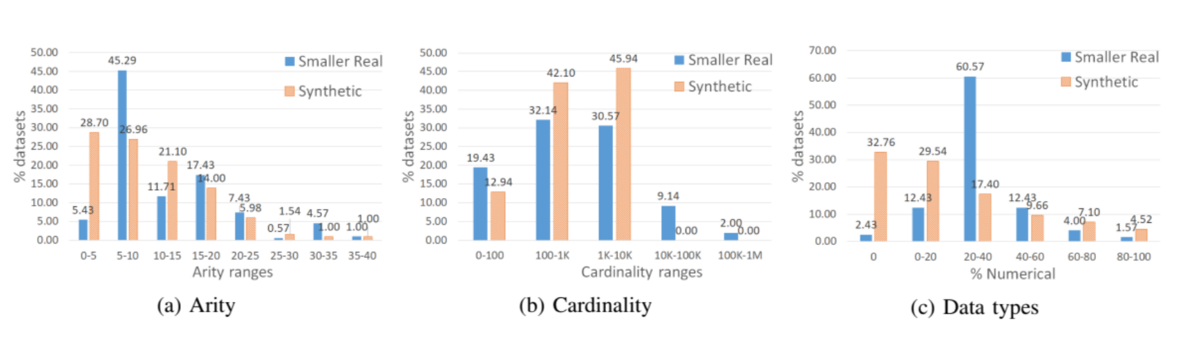
The arity, the cardinality and the percentage of numerical attributes influence the top-k ranking, target coverage, similarity estimation, and join path discovery of the two repositories.
Figure describes the arity, the cardinality and the percentage of numerical attributes of the two repositories used in measuring effectiveness. Arity can have a significant impact on the top-k ranking, i.e., sources with many similar attributes tend to be ranked higher by our weighted scheme, and on target coverage, i.e., the number of attributes related to some target attribute. Cardinality influences the accuracy of similarity estimation and of join path discovery, i.e., a high overlap between instance values determines a high probability of collisions between MinHash hashes.

Slide 13
Baselines and Reported Measures
TUS is a unionability measuring framework which uses three types of evidence from instance values to measure unionability between datasets from different viewpoints. TUS uses similar indexing and querying models to D3L and, therefore, it is a good candidate for a comparative analysis against D3L w.r.t. both effectiveness and efficiency.
Aurum uses both schema– and instance–level information to identify different relationships between attributes of a data lake. A two–step process profiles and indexes the data, creating a graph structure that can be used for keyword search, unionability, or joinability discovery. This makes Aurum a good candidate for a comparative analysis against D3L w.r.t. indexing time, effectiveness, and the added value of join paths
For computing precision and recall, we define a true positive, false positive, and false negative for each table from repository R.
precision p = TP/( TP +FP )
recall r = TP/(TP + FN)

Slide 14
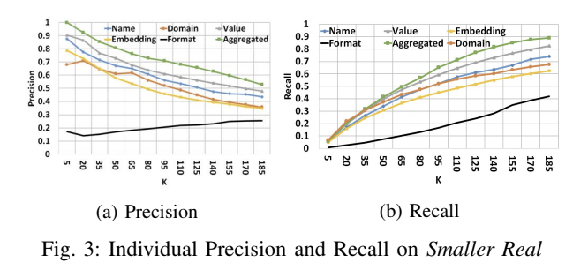
Individual Effectiveness
We first evaluate the effectiveness of evidence types using the Smaller Real repository. The results suggest that evidence types have a poor precision and recall in comparison with the combined approach.
There are many different attributes that represent different entities, and only embeddings and values yield high precision and recall.
Performing the same experiment for non-numerical attributes results in an average decrease in precision and recall of less than 3.5% each.

Slide 15
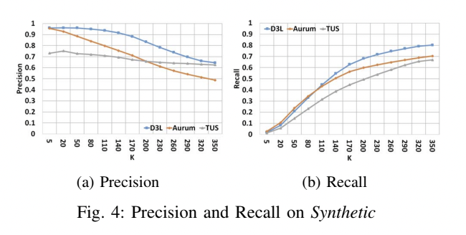
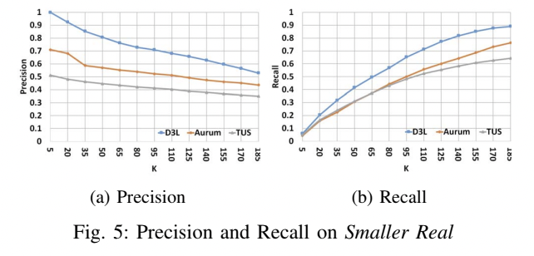
Comparative Effectiveness
D3L performs better than the baselines because it is able to balance high scores in one dimension with a score in another dimension to reduce the number of false positives.
D3L uses multi - evidence relatedness discovery to guard against too many misses, while TUS and Aurum are less dependable than content - based evidence.
D3L provides a better performance when identifying highly related datasets than TUS and Aurum, because the value - based similarity evidence used by TUS and Aurum expect equality between the instance values of similar attributes.
D3L can identify related datasets at an average answer size of 110 points, while TUS and Aurum can only identify around 55%.

Slide 16
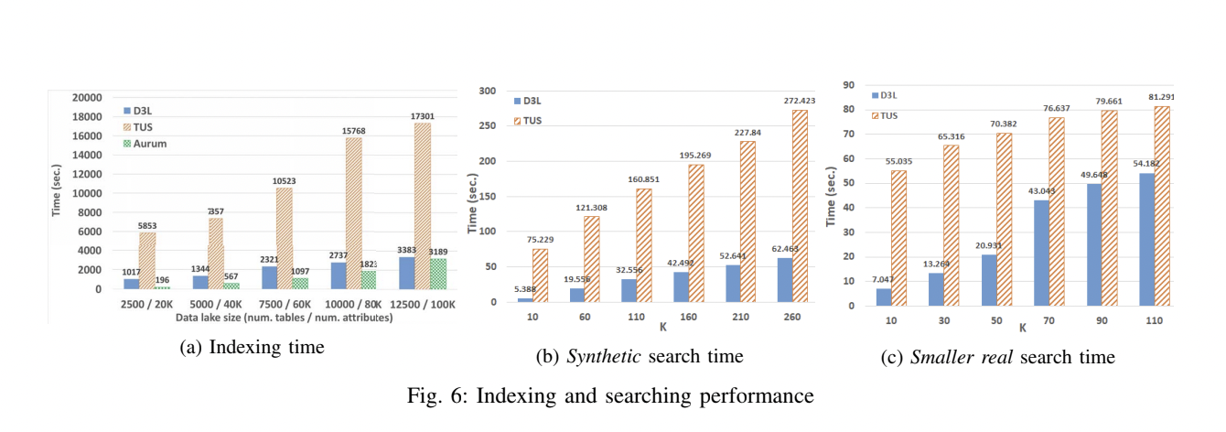
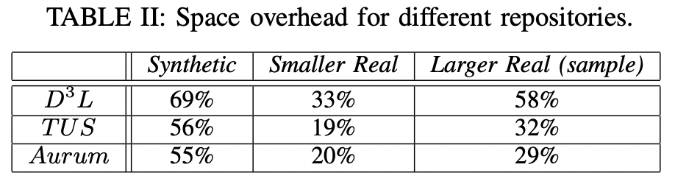
Comparative Efficiency
Comparing D3L and TUS, we have found that D3L performs better on small and medium sized lakes, while Aurum performs better on larger ones. The dominant task in all three systems is data preprocessing, while in Aurum it is graph structure creation.
The D3L and TUS query model is the most affected by the answer size parameter, but Aurum is not.
For Synthetic, D3L performs much better than TUS.
D3L occupies less space than TUS and Aurum for both synthetic and real repositories. This is because D3L uses more relatedness evidence and has fewer indexes.

Slide 17
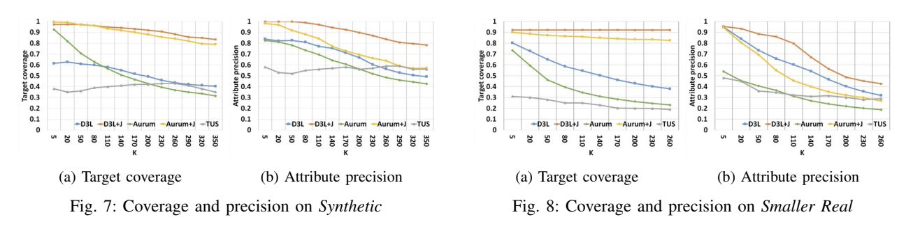
Impact on Join
Opportunities
We have augmented the top-k solution by adding datasets (from D3L + J and Aurum + J), but our hypothesis is that join paths allow us to identify relevant datasets that are not part of the initial ranked solution but can improve the target coverage.
Using join paths from the top-k datasets of D3L + J and Aurum + J leads to a higher coverage of the target, especially for small datasets. This is due to the use of finer grained features, as well as the multi-evidence similarity signals considered by D3L + J and Aurum + J. The top-k solution only covers approx. 25% of target attributes.
D3L is better than TUS and Aurum at covering target attributes for the entire interval of k values, because it retrieves higher quality datasets from the lake. The datasets retrieved by TUS and Aurum are only relevant for populating the target attributes of at most 50% and 70%.
The precision of D3L is increased by the ability to identify attribute relatedness even when the format representation of values differs. It is preserved by joining tables from the join paths.

Slide 18
Conclusions
We have used schema and instance based features to construct hash-based indexes, and can take hash values similarity as relatedness measurements.
We can use schema and instance - level features to identify related entities, which can be used to create a uniform distance space, and to discover join paths using LSH evidence.
the use of schema and instance–level fine–grained features that are more effective in identifying relatedness, especially when similar entities are inconsistently represented;
the mapping of these features to a uniform distance space that offers an aggregated view on the notion of relatedness, to which each type of similarity evidence contributes
the discovery of join paths using LSH evidence and subject–attributes that leads to an increased and precise target coverage
The approach is more effective and more efficient in dataset discovery, when compared to TUS. And more effective in dataset discovery, but at the expense of efficiency, when compared to Aurum.

Slide 19
Thank You!

